Slide 1

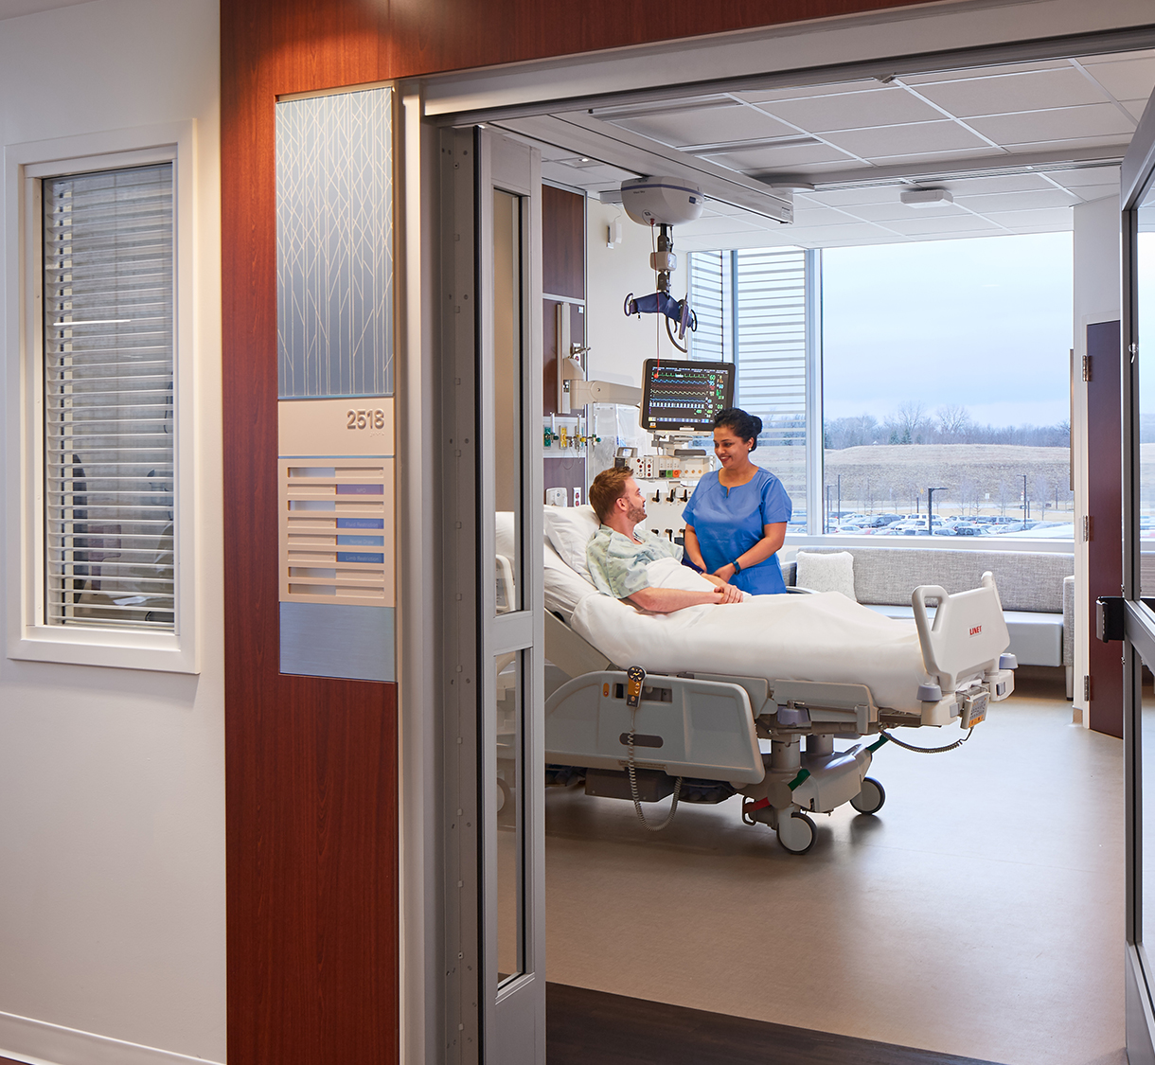

Title of the presentation
Subhead for the presentation
Date goes here

Slide 2
Page headline goes here, can be up to two lines
Optional subhead goes here if needed
First level is Content Header
Second level indent is not bullets, copy aligns with Content Header, Title, Subhead and “Northwestern Medicine” logo text.
Third level indent is the first level bullets
Fourth level indent is second level bullets
Fifth level indent is third level bullets

Slide 3
Page headline goes here
Optional subhead goes here if needed
First level is Content Header
Second level indent is not bullets, copy aligns with Content Header, Title, Subhead and “Northwestern Medicine” logo text.
Third level indent is the first level bullets
Fourth level indent is second level bullets
Fifth level indent is third level bullets
First level is Content Header
Second level indent is not bullets, copy aligns with Content Header, Title, Subhead and “Northwestern Medicine” logo text.
Third level indent is the first level bullets
Fourth level indent is second level bullets
Fifth level indent is third level bullets

Slide 4
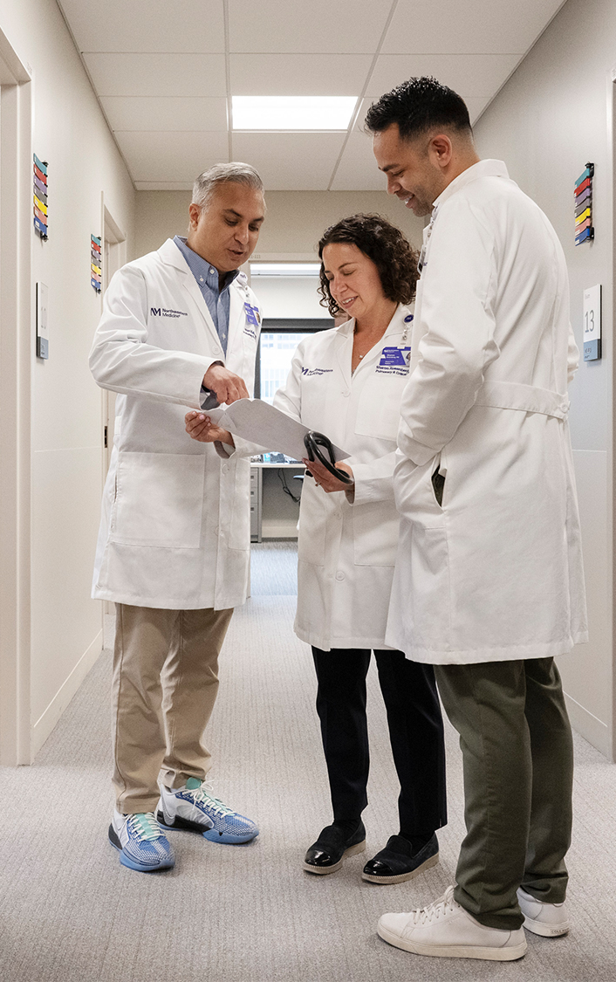
Page headline goes here, up to two lines
Optional subhead goes here if needed
First level is Content Header
Second level indent is not bullets, copy aligns with Content Header, Title, Subhead and “Northwestern Medicine” logo text.
Third level indent is the first level bullets
Fourth level indent is second level bullets
Fifth level indent is third level bullets

Slide 5

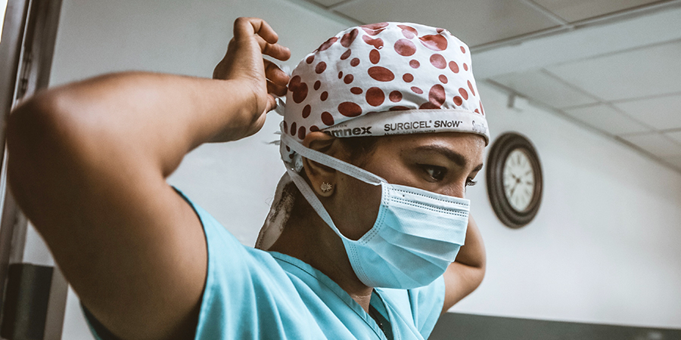
Page head goes here, up to two lines
Optional subhead goes here if needed
First level is Content Header
Second level indent is not bullets, copy aligns with Content Header, Title, Subhead, Picture and “Northwestern Medicine” logo text.
First level is Content Header
Second level indent is not bullets, copy aligns with Content Header and picture for this column of text.

Slide 6







Page headline goes here, up to two lines
Optional subhead goes here if needed
Nonsecte elis la:
568
Eugiatet Velessim
421
116
71
Vendiamet
Dolortin Scillummy Wisi
Veriliquat am Vendreet Eros
181
43%
Exeriurero Diat
33%
Irillamet ip Y1y*
Sisi Suscipi
Nonseni tate Dionsenim wisim
Nonsequi volestisl veliquam ig veliquat quismolor
Suscipi minis Y1y: 10.7%
Facinim tate Y1e: 7.2%

Slide 7
Page headline up to two lines
Optional subhead or chart title
Academic Medical Center (AMC)
Academic Medical Center (AMC)

Slide 8
Page headline goes here, up to two lines
Optional subhead goes here if needed
Content Header
Second level indent is not bullets, copy aligns with Content Header, Title, Subhead and “Northwestern Medicine” logo text.
Third level indent is the first level bullets
Fourth level indent is second level bullets
Fifth level indent is third level bullets

Slide 9
Page headline goes here, up to two lines
Optional subhead goes here if needed
Content Header
Second level indent is not bullets, copy aligns with Content Header, Title, Subhead and “Northwestern Medicine” logo text.
Third level indent is the first level bullets
Fourth level indent is second level bullets
Fifth level indent is third level bullets

Slide 10
Page headline goes here, up to two lines
Optional subhead goes here if needed
Content Header
Second level indent is not bullets, copy aligns with Content Header, Title, Subhead and “Northwestern Medicine” logo text.
Third level indent is the first level bullets
Fourth level indent is second level bullets
Fifth level indent is third level bullets

Slide 11
Page headline goes here, up to two lines
Optional subhead goes here if needed
Header Copy 16 pt. | Header Copy 16 pt | Header Copy 16 pt | Header Copy 16 pt | Header Copy 16 pt
Information copy 12 pt Aptos | Information copy 12 pt Aptos | Information copy 12 pt Aptos | Information copy 12 pt Aptos | Information copy 12 pt Aptos
Information copy 12 pt Aptos | Information copy 12 pt Aptos | Information copy 12 pt Aptos | Information copy 12 pt Aptos | Information copy 12 pt Aptos
Information copy 12 pt Aptos | Information copy 12 pt Aptos | Information copy 12pt Aptos | Information copy 12 pt Aptos | Information copy 12 pt Aptos
Information copy 12 pt Aptos | Information copy 12 pt Aptos | Information copy 12 pt Aptos | Information copy 12 pt Aptos | Information copy 12 pt Aptos
Information copy 12 pt Aptos | Information copy 12 pt Aptos | Information copy 12pt Aptos | Information copy 12 pt Aptos | Information copy 12 pt Aptos

Slide 12

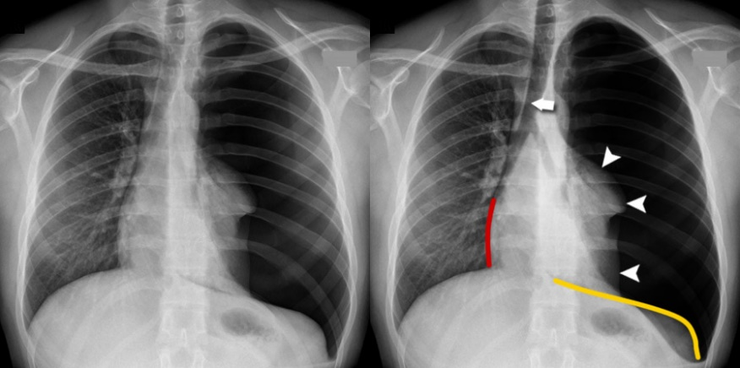
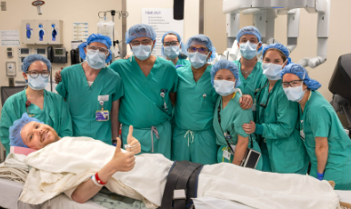
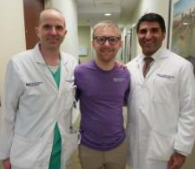
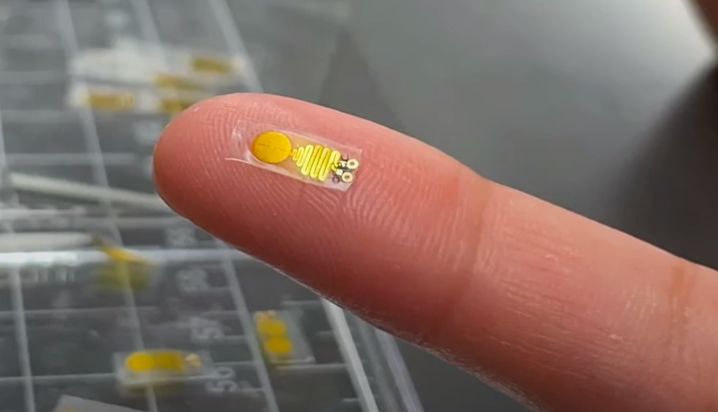
Page headline goes here, up to two lines
First level is Content Header
First level is Content Header
First level is Content Header
Implantable bioelectronic systems for early detection of kidney transplant rejection
Feugiat scillummy ad na iusci molum hendrer enim dolortio molum
Volestisl esse to exerostrud dolorem molent
Vullutat delesto conullam lor iriuscing
75% Euguerostie it veliquiscil atueraestrud
~6re Duiscipit an tetummy eros erit pit E-tie amconul
~35-40% ut euip hendrem lam Y-tet aliquipsusciea
Conulputat bla quis mod feuisci ullamcommy, ud vullan facipsustio velesequipiteea
Ptatueros ncidui er dolorperiureyna lum eraessit tio ate elit-alis do feugiam amconul voloreetum
Consequat Lumsan si Quip

Slide 13




Page headline goes here, up to two lines
Optional subhead goes here if needed
Tate Lum
Wisi Ulput
Wissis
Et volorep eratiur aut ut exerovidis experes sit aut modissit vere
Volore pos non cone mil inumquos busdant fuga
Unt initia volentem etur aut quatem
Nonsecte Exeriurero Dolorem wisl conullam duiscipit heniamc
Velessim conse ationse do lor Eraessit Mincip Atue
Ver Molore it Quamcommy TET Feugiat
Iurerosto Veliquam
Feugiat Eugiatet
23.6%
20.8%
16%
14.8%
Quamcomy Andreet
Elesequisim
Blandipis heniamc atueraestruda
Veliquiscil vullam vel feugiat
Nissectet feugiam quis adipsustru
Dolortis vulput aciliquisim nissectet dunt 80% na ibh ptatueros
Niatuero eu scillummy facillametum adionsequat ibh sent 90% el exeriurero
24% veliquat el heniamc amconul adigniscipis
54% veleniat od atuerat atem duiscipit heniamc adigniscipis
5.4% quismolor feuismo, a 3.6% velessim vullutat ud amet dion, quip 10 doluptat magnis in facinim vendreet
+2,448 nis commy re nit quam 12 minisi

Slide 14
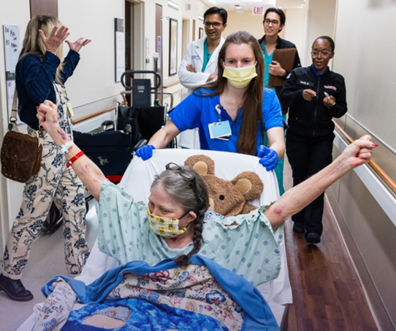



Page headline goes here, up to two lines
Optional subhead here
Bold text is first indent level
Bullets are third indent level
Minisl 90% at nonsenim elis ecte vullutat dip Lumsan Ulputpatetue od Magnim minisi nis Mconse Lorper, 92a velenibh velestis eraessit
Bold text is first indent level
Bullets are third indent level
$47 feuisis minit quat ute Adigniamcore Dionsenim Henia mc, 60% consequi amet qui eros esed lenit
Bold text is first indent level
Bullets are third indent level
9,400+ nissectet lorem, a 132% dolortin tate-amet-ting

Slide 15
Page headline here, up to two lines
Optional subhead if needed
Lorer Do Atum
Vendreet na augiametuer etue ad y enis & eniatisit nim lum EU Duiscipit
Ver Nullaortis?
Uipsuscidunta in nullandiat ncidui laore mod eniatisit dio erciduisit y lobor nit feuisis dit vulput veleniat
Digniamet RIL ad sisi dolortie qui veliquam e eugiamet molore ip laore eugiamet minisi pis essi eugiatet minisl
Nit Am Enit
Nismodit e amconsequis ute duiscipit exeraestrud elit nonsequi y lutem eu facinim min feuguer wiscil nit Quismolor
Tie et Wiscip, Lorper, & Hendrer
Commod ut rit tumsandionse lis velessim dolortis in con IP Irillamet
TIO EM feu Enit LOR

Slide 16
Divider or Section
Additional text to explain the section of the presentation.

Slide 17
Thank you

Slide 18













Icons
Choose from the selection on this and the following page
ambulance
badge
bandage
calendar
certificate
checkup
clipboard
clock
communication
document
donut chart
evaluation
evidence
experience
growth
health

Slide 19
















Icons, continued
hospital
idea
lab
location
Medical records
medical
medication
microscope
network
office
Online help
report
search
settings
solution
statistics
stethoscope
surveys
talking
team
telephone
thinking
treatment
vision

